Slide 1
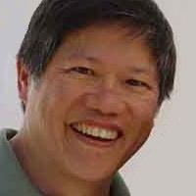
https://wilsonmar.github.io/ IoT-reminders
@WilsonMar
Skype: wilsonmar4
wilsonmar@gmail.com

Slide 2
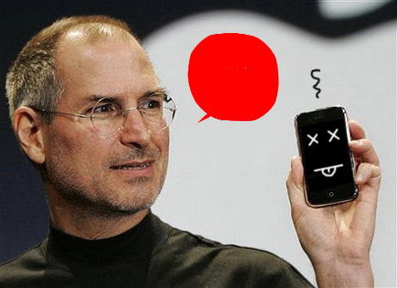

Slide 3
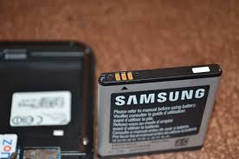

Slide 4

Notes:
http://www.howtogeek.com/236278/how-to-use-the-reminders-app-on-your-mac-or-iphone-and-never-forget-something-again/

Slide 5
Reminder things
Escalation (drag and drop to arrange)
Text phone 1
Number:___________
Call phone 2
Number: ___________
Light bulb 1
Color: _____________
Alarm 1
Decibels: __________
Vibrate bed
Level: _____________
Vibrate floor
Level: _____________
Say 1
Text: ______________
+ more

Slide 6
Notes:
http://www.sebertech.com/2015/08/how-to-troubleshoot-quick-battery.html

Slide 7




Wi-Fi
BTLE
REST
ZigBee
GraphQL
LTE
LoRa
XMPP
SPARQL

Slide 8

http://emergingtech.tbr.edu/
i-can-show-you-grandma

Slide 9


Slide 10

Notes:
https://amandabeattie.wordpress.com/2009/07/07/blame-the-game-where-everyone-loses/
http://www.publicdomainpictures.net/view-image.php?image=162787&picture=pointing-finger-hand-banner-hand
http://nomorejealousy.com/whose-fault-is-jealousy/

Slide 11


Slide 12
Smart watch
Notes:
http://newatlas.com/smartwatch-comparison-2015/38452/#p353558

Slide 13
calendars
iot-reminders-v03.pptx
@Copyright Wilson Mar 2016.
All rights reserved.
Jenkins, other sys.
Black Box
API
alerting logic
Apple iTunes Store
app on iOS
analysis
register
update
text / call phones
receiver
trends
GPS
router
retriever
dispatcher
settings
Google Play Store
app on Android
collector
Actuators:
Sensors:
button
external
sensors
vibrate
Wi-Fi
.wav & TTS
BTLE
NLP
siren
ZigBee
bulb
LTE
Mic.
sounds
LoRa
https://wilsonmar.github.io/ iot-reminder

Slide 14
Button
One click
Remind again in _____ minutes
Two clicks
Call the phone (so I can find it)
Long press
Ignore (let the battery drain)

Slide 15
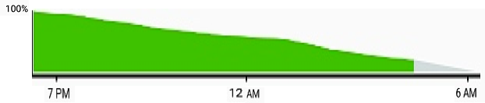
End-point:
Mac App Store
direct
Credentials:
polling
analysis
alerting logic
XCode on Mac
cloud
trends
Android Studio
Amazon App Store

Slide 16
Light bulb
Device:
Phillips
+ more
Color:
Red
+ more
Pattern:
On 1 sec. Off
+ more

Slide 17
https://wilsonmar.github.io/ IoT-reminders
@WilsonMar
Skype: wilsonmar4
wilsonmar@gmail.com

